Slide 1
第8-2章: Network Based Inference
Network based function prediction
Markov random field model
Kernel logistic regression method
Network based gene expression study
Hidden Markov random field

Slide 2
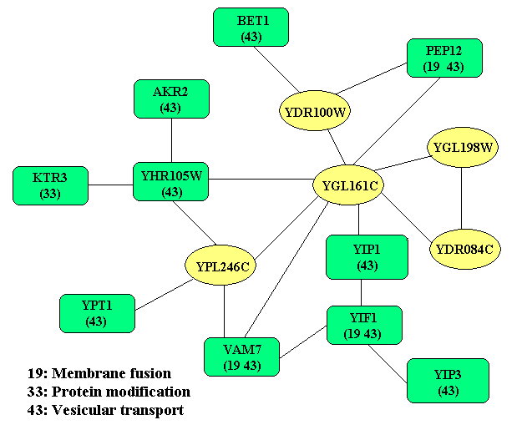

Slide 3
Protein Functions
YPD (Yeast Proteome Database).
MIPS (Munich Information Center for Protein Sequences).
GO (Gene Ontology).
Hierarchical: MIPS, GO.
Non-hierarchical: YPD.

Slide 5
Multiple Function Problem
We consider each function separately. 1-0 problem

Slide 6
Functional Clues
Sequence similarity (BLAST).
Domain, motif, transcriptional factor binding, as well as some signals in sequence.
Phenotype data.
Gene expression (clustering)
Protein-protein interactions

Slide 7
Protein-protein Interactions
DIP (Database of Interacting Protein).
BIND (The Biomolecular Interaction Network Database).
GRID (The General Repository for Interaction Datasets).
MIPS physical interaction.

Slide 8
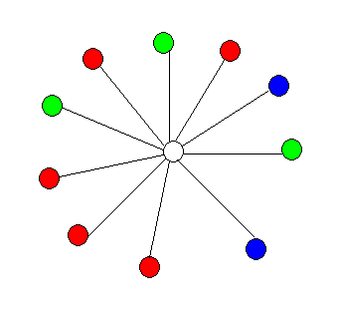
Basic Idea
Interacted proteins are more likely to be in the similar function group, so we can infer the function of the unknown proteins by their interaction partners.

Slide 9

Two Basic Methods
Neighborhood-counting method (Schwikowski 2000)
Chi-square method (Hishigaki 2001)
Where p_{i} is the fraction of protein having the ith function in the whole map.
Local Global
Notes:
“neighborhood-counting method” assigns k functions to a protein with the k largest
frequencies in its interacting partners and “chi-square method” assigns k
functions to a protein with the k largest chi-square scores. The chi-square score is
defined in following fomula, which not only consider the number of partners, but also
consider the fraction of proteins having a certain function in the global network.
For example, as in the figure, the protein with white color is interacted with 10
proteins, 5 partners with one function “Red”, 3 partners with another function
“Green”, and 2 partners with another function. If we choose the function with the highest
Score, then by neighborhood-counting method, we assign “Red” to the white protein.
Chi-square method consider the fraction of proteins having a certain function
in the global mapping. For example, if the fraction is 0.6, 0.3, 0.1 for “RED”,
“Green” and “BLUE”, then the chi-square score are 1/6, 0.0, 1.0. We assign
Function “Blue” to the protein in the center.

Slide 10
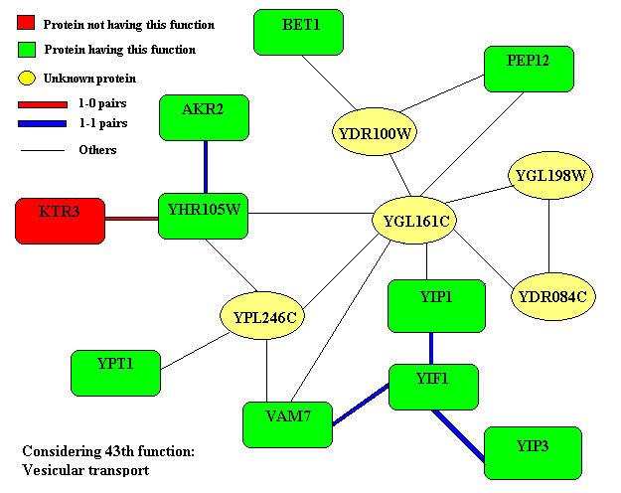

Slide 11
Markov Random Field (MRF)
Motivation: proteins involved in same functional process are likely to interact.
Without interaction data, the probability of functional labeling
N₁: # proteins with the function
N₀: # proteins without the function
π: fraction of proteins with the function

Slide 12
Given the interaction data, our believe for the network is proportional to
N_{ij}: # interacting protein pairs one with annotation i and the other j
Combining the above two equations, the Gibbs distribution is
The potential function

Slide 13
Mathematical Problems
Estimate the parameters in the model
Estimate the posterior probability of the annotations for the unannotated proteins conditional on the functions of the annotated proteins

Slide 14
Estimation of Parameters
Using sub-network containing annotated proteins only.
A Logistic model can be derived (maximum psudo-likelihood estimation).

Slide 15
Logistic Regression
Observed data:
Response | X₁ | X₂ | ☹ | X_{n}
y₁ | x₁₁ | x₁₂ | ☹ | x_{1n}
y₂ | x₂₁ | x₂₂ | ☹ | x_{2n}
☹ | ☹ | ☹ | ☹ | ☹
y_{N} | x_{N1} | x_{N2} | ☹ | x_{Nn}
Maximum likelihood estimation, the likelihood function is

Slide 16
Gibbs Sampler
Sampling the assignment with probability

Slide 17
Algorithm
Initialization. Assign function (1 or 0) for unannotated proteins with prior probability
Update the function assignment for each unknown protein until convergence
Compute the posterior probability for each protein based on other proteins (interaction partners).
Assign function (1 or 0) for it based on this posterior probability
Output

Slide 18
Iterative Conditional Mode
Greedy assign function according to the conditional probability

Slide 19
Data
YPD (Feb.15, 2002), 6281 proteins, 43 classses of “cellular role.”
MIPS physical interactions: 2559 interaction pairs, 120 self-interaction
 |  | Number of interaction partners
 | All | 0 | 1 | 2 | 3 | 4 | 5 | >=6
Annotated | 3854 | 2399 | 1455 | 785 | 514 | 346 | 252 | 186
Unannotated | 2427 | 2005 | 422 | 131 | 45 | 15 | 12 | 7
Total | 6281 | 4404 | 1877 | 916 | 559 | 361 | 264 | 193

Slide 20
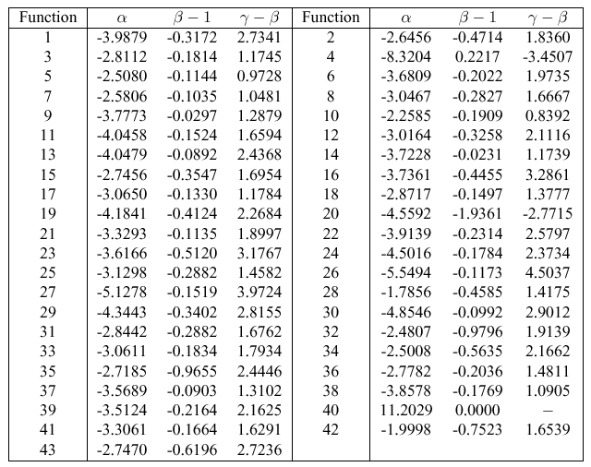
Estimated Parameters

Slide 21
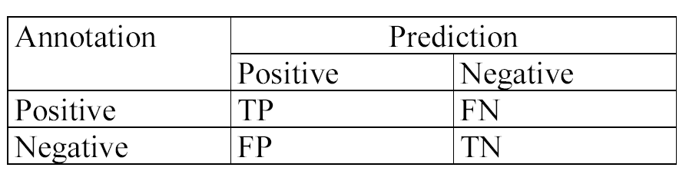
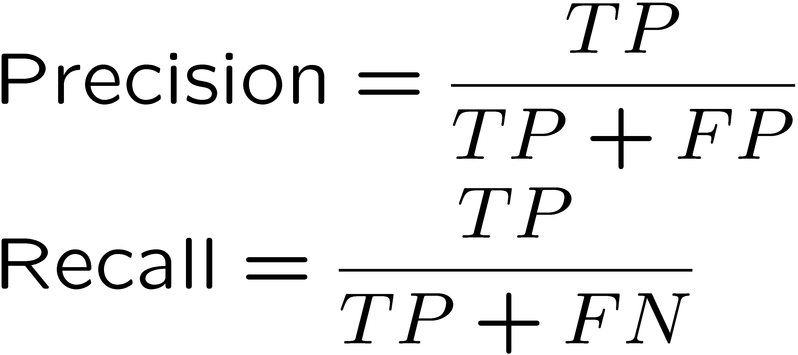
Cross Validation
Leave-one-out test.
Precision
fraction of the correct predictions within all predictions.
Recall
Fraction of the correct predictions within all the test samples

Slide 22
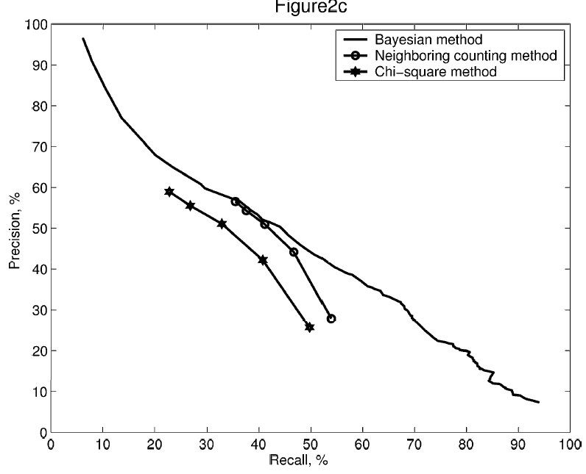
Comparison of Different Methods

Slide 23
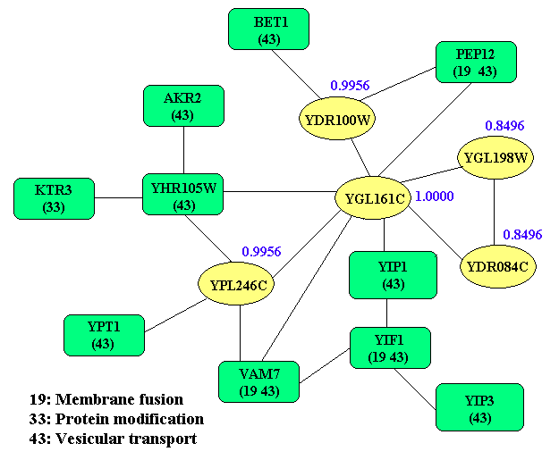

Slide 24
Extending MRF to Incorporate Other Data Sources
Interactions - pairwise
Physical Interaction (MIPS)
Genetic Interactions (MIPS)
Highly correlated Gene Pairs (SGD)
Complex/Cluster - groups
Protein Complex (TAP)
Gene Cluster
Sequence Features
Protein domains (Pfam)

Slide 25
A General MRF Model
Domain
Information
Other
Sequence
Features
Physical
/Genetic
Interactions
Highly
Correlated
Gene Pairs
Other
Associated
Gene Pairs
Protein
Complexes
Other
Gene
Clusters
Feature
Distribution
Interaction
Networks
Functions for
Complex/Cluster
MRF Model
Prediction
New Functions for
Known Proteins
Cross Validation
Functions for
Unknown Proteins

Slide 26
Key Points in MRF
The prior probability of an unknown protein, X_{i}, is obtained from protein complex information.
Given the functional assignment of a protein, the probability of sequence features and domain information
Given the functional assignment of all the proteins, the believe of all the networks

Slide 27
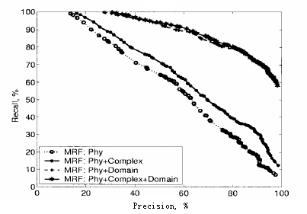
Leave-one-out Test for Known Proteins
Deng et al. 2004, J. Comput. Biol.,11:463-475

Slide 28
Related Works
Letovsky and Kasif, ISMB2003, also Bioinformatics 19-Sl: i197-i204 (MRF)
Vazquez et al. Nature Biotech., 2003 (Ising model, simulated annealing)
Karaoz et al. PNAS, March 2, 2004. (MRF)
Lanckriet et al. PSB 2004 (SVM)
Leone and Pagnai. Bioinformatics 21: 239-247, 2005. (MRF, loopy message passing)

Slide 29
Other Works
Samanta and Liang, PNAS 100:12579-12583, 2003.
Criteria: if two proteins share significantly larger number of common interaction partners than random, they have close functional associations.
Zhou et al. PNAS 99: 12783-12788, 2002.
Transitive Functional Annotation by shortest path analysis of co-expressed gene network.
Module based methods

Slide 30
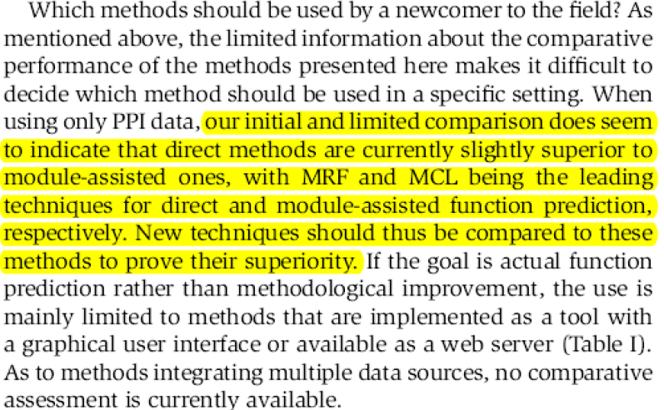
A Good Review Paper
Sharan et al. Mol. System Biol. 2007

Slide 31
References
Schwikoski et al. 2000, Nature Biotech.18:1257-1261
Hishigaki et al. 2001, Yeast, 18:523-531
Zhou et al. 2002, PNAS, 99: 12783-12788
Deng et al. 2003, J. Comput. Biol.10: 947-960
Letovskyet al.2003, Bioinformatics, 19-Sl: i197-i204
Samanta et al. 2003, PNAS, 100:12579-12583
Vazquez et al. 2003, Nature Biotech., 697-700
Deng et al. 2004, Bioinformatics,20:895-902
Deng et al. 2004, J. Comput. Biol.,11:463-475
Lanckriet et al. 2004, PSB, 300-311
Karaoz et al. 2004, PNAS, 101:2888-2893
Leone et al. 2005, Bioinformatics, 21: 239-247
Sharanet al. 2007, Mol. System Biol.3: 88

Slide 32
Kernel Logistic Regression Model
Kernel logistic regression method
Yeast function prediction
Mouse function prediction
References:
1. Lee et al. Omics: integrative biology, 2006.
2. Pena-Castillo et al., Genome biology, 9:S2, 2008.

Slide 33
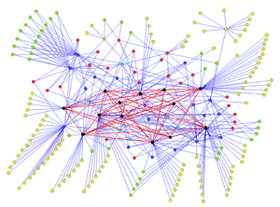

Kernels for Protein Interaction
Motivation: Two interacting proteins are more likely to share similar functions
Adjacent kernel

Slide 34
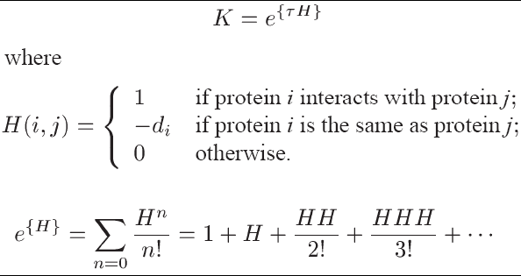
Diffusion Kernel for Protein Interaction
Diffusion kernel K calculates the similarity distance between any two nodes in the network

Slide 35
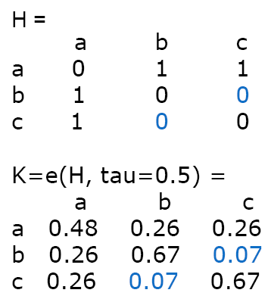
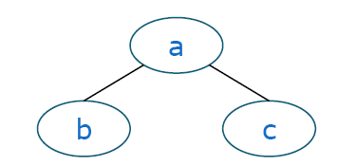
Diffusion Kernel for Protein Interaction

Slide 36
Kernels for Other Data
Gene expression
Domain: suppose v_{i} is the domain membership of protein i

Slide 37
Kernel Logistic Regression Model (I)
Assume: Probability for X

Slide 38
Kernel Logistic Regression Model (II)

Slide 39
Kernel Logistic Regression Model (III)
Multiple data integration
D: number of data sources
: the kernel matrix of d-th data source

Slide 40
Yeast Data Sets
Yeast protein functions
Protein : gene list from the SGD database
Function : 34 functions from Gene Ontology (GO) biological process
Physical protein interactions
2,566 interactions from MIPS (http://mips.gsf.de)
Protein-domaininteractions
Pfam(http://www.sanger.ac.uk/Software/Pfam/iPfam/)
Protein localization
Huh et al.(2003)
Protein complex
Ho et al. (2002). high-throughput mass spectrometric protein complex identification (HMS-PCI)

Slide 41
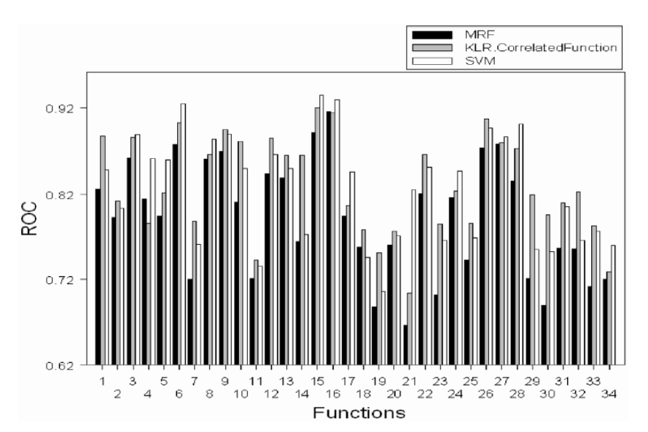
Comparison of Different Methods
Lee et al. Omics: integrative biology 2006

Slide 42
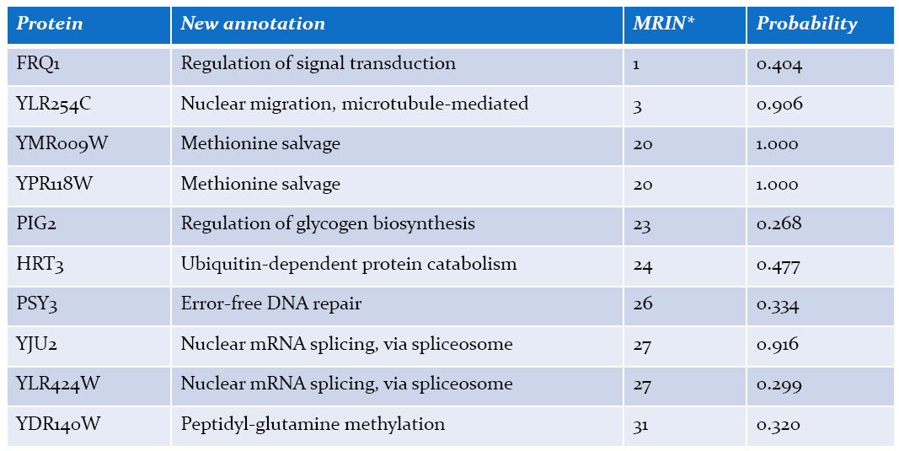
Validation of Predictions
Ten newly added annotated proteins (probability > 0.2) between May 2003 and December 2005, and their function annotations
Lee et al. Omics: integrative biology 2006

Slide 43
Mouse Function Prediction
Motivation: Evaluation of computational function prediction for mammals
Nine bioinformatics teams participated.
A standardized collection of mouse functional genomic data;
GO functional categories;
21603 mouse genes (76%);
Randomized training data.
Randomized held-out test data.
Novel test data.

Slide 44
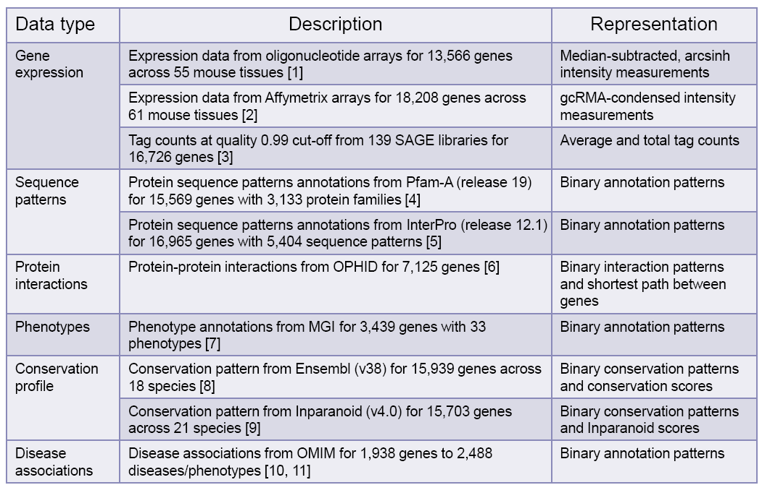
Data Sets (I)

Slide 45
Data Sets (II)
Zhang W et al. J Biol2004, 3(5):21.
Su AI et al. PNAS USA 2004, 101(16):6062–7.
SiddiquiAS et al. PNAS USA 2005, 102(51):18485–90.
Finn RD et al. Nucleic Acids Res 2006, 34:D247–51.
MulderNJ et al. Nucleic Acids Res 2005, 33:D201–5.
Brown KR, JurisicaI: Bioinformatics 2005, 21(9):2076–82.
EppigJT, Nucleic Acids Res 2007, 35:D630–7.
KasprzykA et al. Genome Res 2004, 14:160–9.
O’Brien KP et al. Nucleic Acids Res 2005, 33:D476–80.
Wheeler DL et al. Nucleic Acids Res 2007, 35:D5–12.
Hamosh A et al. Nucleic Acids Res 2005, 33:D514–7.

Slide 46
On Held-out Test Data

Slide 47
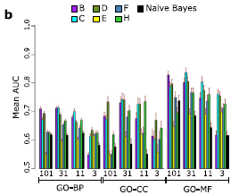
On Novel Test Data

Slide 48
Network-based Genomics Analysis
References
Zhi Wei and Hongzhe Li. A Markov random field model for network-based analysis of genomic data. Bioinformatics 23(12): 1537–1544,2007.
Hongzhe Li, Zhi Wei and John Maris. A hidden Markov random field model for genome-wide association studies. Biostatistics 11(1):139–150, 2010.
Zhi Wei and Hongzhe Li. A hidden spatial-temporal markov random field model for network-based analysis of time course gene expression data. Annals of Applied Statistics 2(1): 408-429, 2008.
Min Chen, Judy Cho and Hongyu Zhao. Incorporating Biological Pathways via a Markov Random Field Model in Genome-Wide Association Studies. PloS Genetics 7(4): e1001353, 2011.

Slide 49
Integrating Network Structure to Gene Expression Analysis
The gene network gives a prior: interacted genes are more likely to have same differential expression pattern.
A Markov random field model is used to model this network constraint.

Slide 50
Hidden Markov Random Field (HMRF)
X: status of genes, differential expression (DE) or equal expression (EE), which is hidden
Y: observed gene expression level of each gene.
Data: Protein-protein interaction network, gene expression profiles with m replicates under one condition, and n replicates under another condition

Slide 51
Gamma-gamma Model for Gene Expression Data
For ith gene, Gamma distribution with latent mean
The latent mean has a inverse Gamma distribution over all genes with shape parameter and scale parameter v.

Slide 52
Gamma-gamma Model for Gene Expression Data
So the joint density is
For genes under the first condition

Slide 53
Gamma-gamma Model for Gene Expression Data
For genes under the second condition

Slide 54
Emission Probability

Slide 55
Emission Probability
Assumption: Given any particular realization x, the random variables Y=(Y₁,Y₂, . . . ,Y_{p}) are conditionally independent.
Assumption: Each Y_{i} has the same unknown conditional density function f(y_{i} | x_{i}), dependent only on X_{i}.

Slide 56
Markov Random Field (MRF)
Using a MRF to model the dependency of differential expression status

Slide 57
Conditional Probability
By considering any two realizations which differ only at gene i,
where is the number of neighbors of
gene i having state 1-k (k=1 or 0)

Slide 58
Psudo-likelihood Estimation of the Parameters
Psudo-likelihood

Slide 59
Algorithm (I)
1. Obtain an initial estimation of the true state x*, using a simple two sample t-test.
2. Estimate by the value which maximizes the likelihood [see equation (1)].
3. Estimate by the value which maximizes the conditional likelihood [see Equation (2)] based on current .

Slide 60
Algorithm (II)
4. Carry out a single cycle of ICM based on the current , to obtain a new . Specifically, for i=1 to p, update x_{i} which maximizes
5. Go to step 2 for a fixed number of cycles or until approximate convergence of .

Slide 61
Simulation Study
Network:1668 nodes and 8011 edges; totally 33 pathways
Genes in the K pathways to be DE and the rest of genes to be EE (k=5,9, 13,17)
r0= 1, r1=1, b=2.
GG model for the expression, 3 replicates in each condition with a=10, a0=0.9, v=0.5
Simulations are repeated 100 times.

Slide 63
Gamma Distribution on Wiki
In life test, the waiting time until death is generally model as Gamma distribution
Density function (shape , scale )
Expectation:
Gamma distribution is the conjugate prior for many distributions
http://en.wikipedia.org/wiki/Gamma_distribution

Slide 64
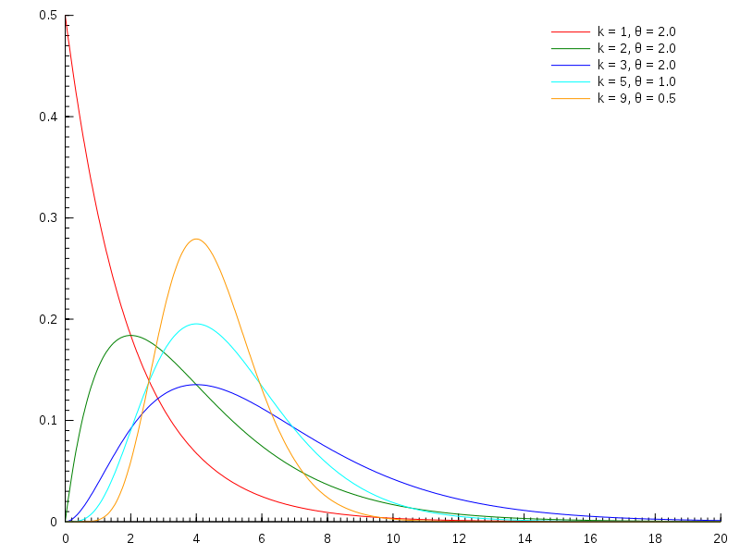
Gamma Distribution on Wiki
http://en.wikipedia.org/wiki/Gamma_distribution

Slide 65
Inverse-Gamma Distribution on Wiki
Density function
E(1/X)=a/b
If X~Inv-Gamma(a,b), kX~Inv-Gamma(a,kb)
If X~Gamma(a,b), 1/X~Inv-Gamma(a,b)
If X~Gamma(k,t), 1/X~Inv-Gamma(k,1/t)
http://en.wikipedia.org/wiki/Inverse-gamma_distribution

Slide 66
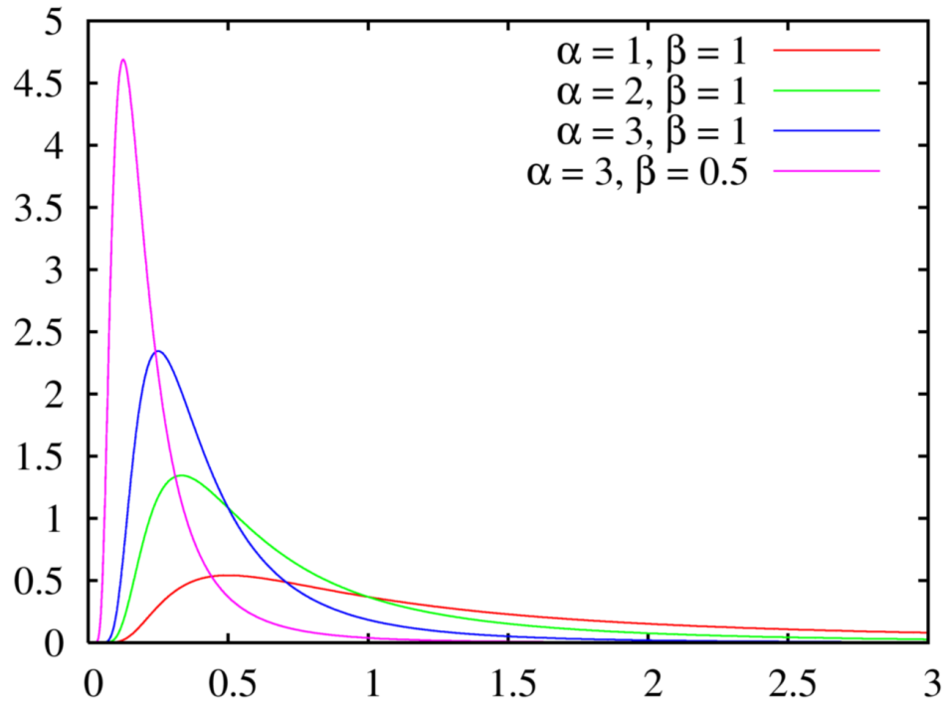
Inverse-Gamma Distribution on Wiki
http://en.wikipedia.org/wiki/Inverse-gamma_distribution

